Slide 1
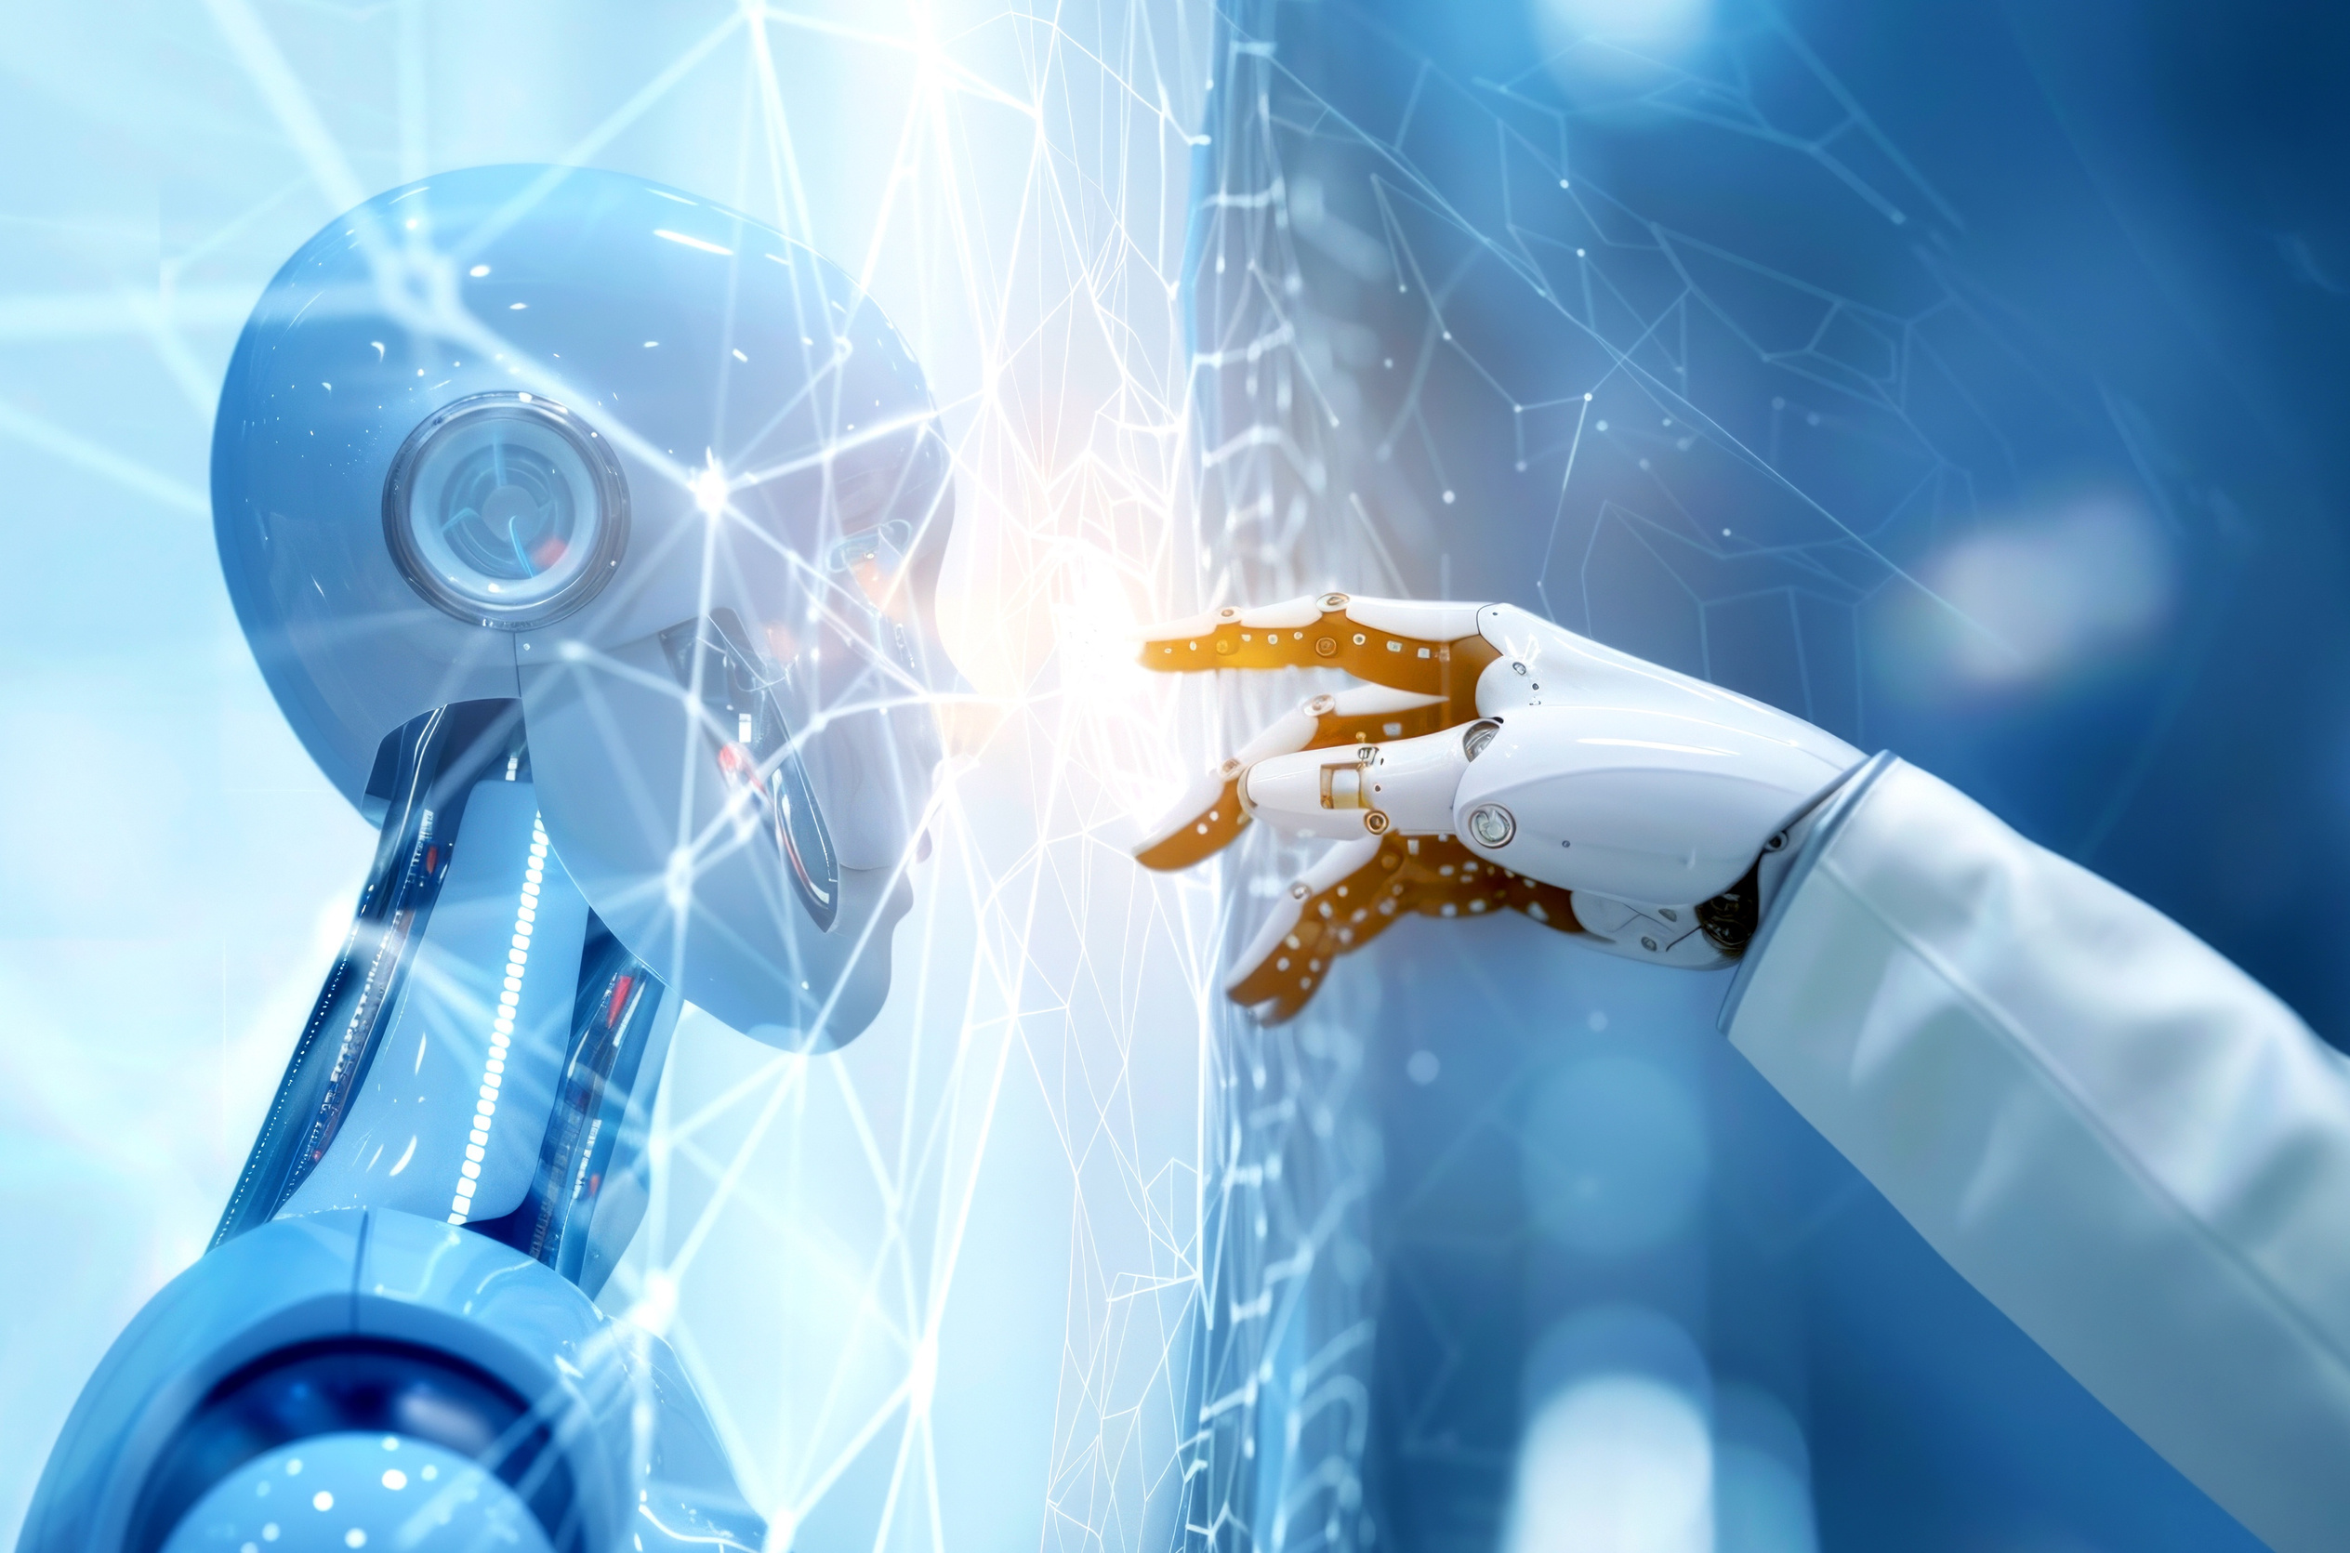
ALL ABOUT
01
ANGELINE

Slide 2



The first version of our robot didn't have a name because it was just a prototype for the national stage. We also encountered several problems with the robot, such as the camera lagging, the driver overheating too quickly, and the camera stopping working when it got too hot, among other issues.
FIRST
02
VERSION

Slide 3
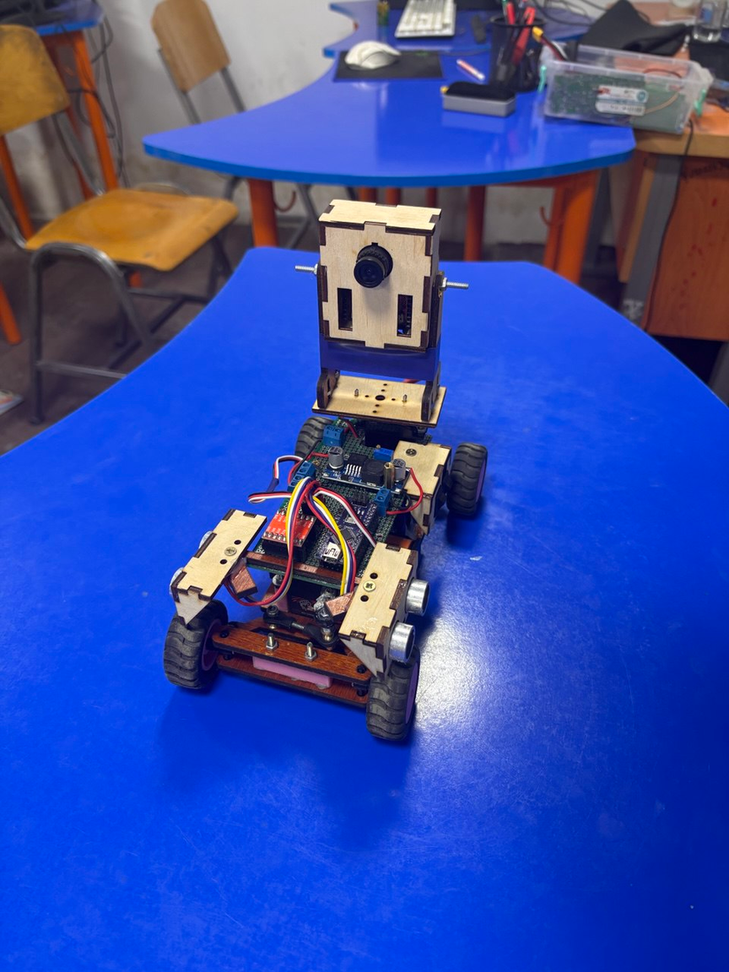
COMPONENTS
FISRT VERSION
Our first robot was equipped with two ultrasonic sensors to maintain its position between two walls. It also had a camera for obstacle detection and lap counting. We used two N20 motors for movement and two servos—one for steering and another for positioning the camera. The main controller was an Arduino Nano, while the OpenMV camera was used specifically for detecting obstacles and counting lines.
Initially, we used the L298D motor driver, but we later upgraded to the more powerful TB6612F driver. The chassis was primarily made of wood, with 3D-printed parts for the steering motors and wheels. This is a brief guide to our robot's setup.
03

Slide 4
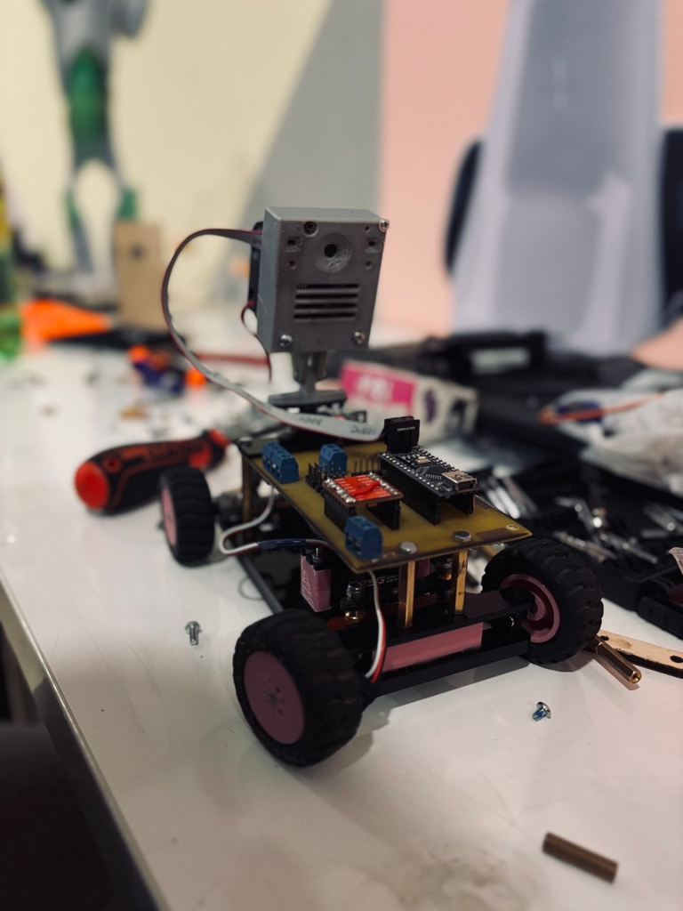
SECOND
VERSION
The second version of the robot was much more beautiful than the first because we used acrylic instead of wood for the chassis. We also upgraded our camera to the PixyCam, which was significantly faster than the OpenMV. Additionally, we designed our own PCB using a copper plate, which allowed us to minimize the number of cables.
We believe that covers it for the final version of the robot.
04

Slide 5
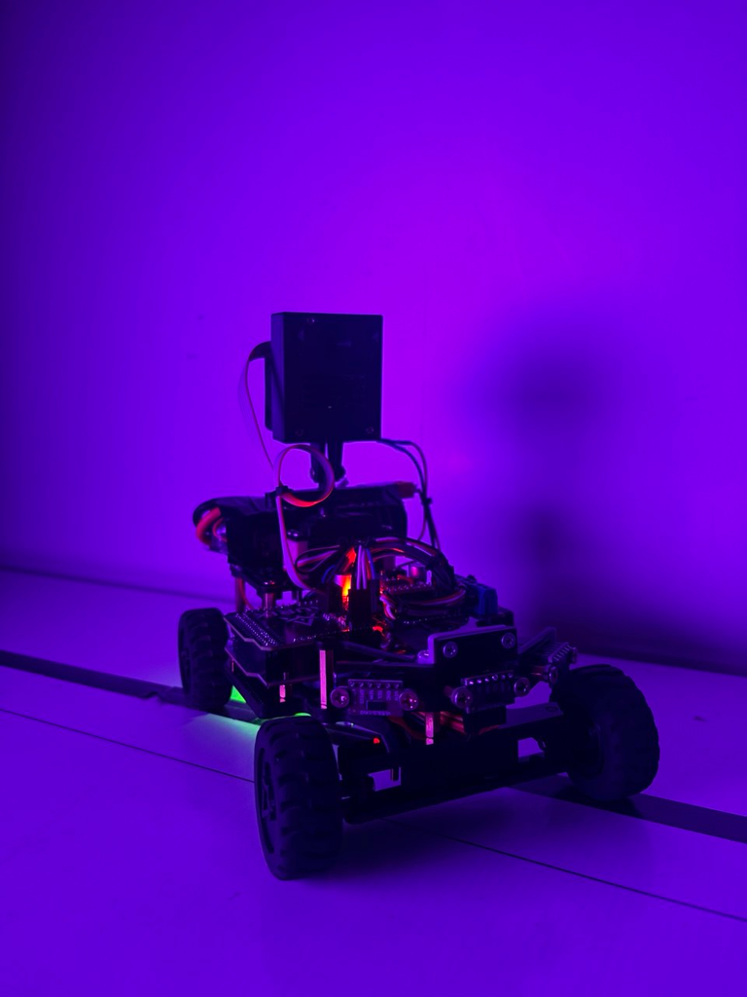
THIRD (FINAL)
VERSION
The latest version of our robot is the best one we've created, featuring numerous improvements. The main change is that we replaced the Arduino Nano with an Arduino Mega, which has more memory. We also added laser distance sensors, which are much smaller than the ultrasonic sensors, allowing us to incorporate three of them. Additionally, we kept ultrasonic sensors for parking on both sides of the robot.
Furthermore, we designed our PCB ourselves and ordered it from PCBWay, which helped streamline the layout and improve the overall performance of our robot.
06

